Slide 1
DevOps:CI/CD
Fancy Acronyms for automation
Troy Nightingale
WDD230

Slide 2
DevOps
A set of practices that combines software development and IT operations.
It aims to shorten the systems development life cycle and provide continuous delivery with high software quality.
Is complimentary with Agile software development

Slide 3
Cloud
What is it?
Virtualization
In somebody’s data center

Slide 4
DevOps Vocabulary
Agile
DevSecOps
IAaS
IAC
SAaS

Slide 5
DevOps Vocabulary
Agile
A software-only form of DevOps.
An iterative form of software development designed to help teams deliver value faster
Delivers work in small, consumable increments

Slide 6
DevOps Vocabulary
DevSecOps
Combine security practices and requirements with DevOps
Ssh, hardened code, patched apps, etc.

Slide 7
DevOps Vocabulary
IAaS – Infrastructure As a Service
A type of cloud computing service that offers essential compute, storage and networking on demand as a pay-as-you-go basis.
eg: AWS, Google Cloud, MS Cloud, Oracle Cloud.

Slide 8
DevOps Vocabulary
IAC – Infrastructure As Code
An approach to managing data center server, storage and networking infrastructure.
Tools – Ansible, Chef

Slide 9
DevOps Vocabulary
SAaS – Software As a Service
A way of delivering applications over the internet instead of buying and downloading software
Examples; email, Office, Slack, Salesforce

Slide 10
DevOps Practices
Continuous Integration
Continuous Delivery
Microservices
Infrastructure as Code
Monitoring and Logging
Communication and Collaboration

Slide 11
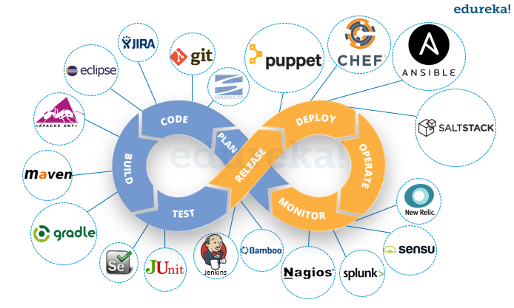

Slide 12
DevOps - examples
Best Buy
AWS

